Slide 1
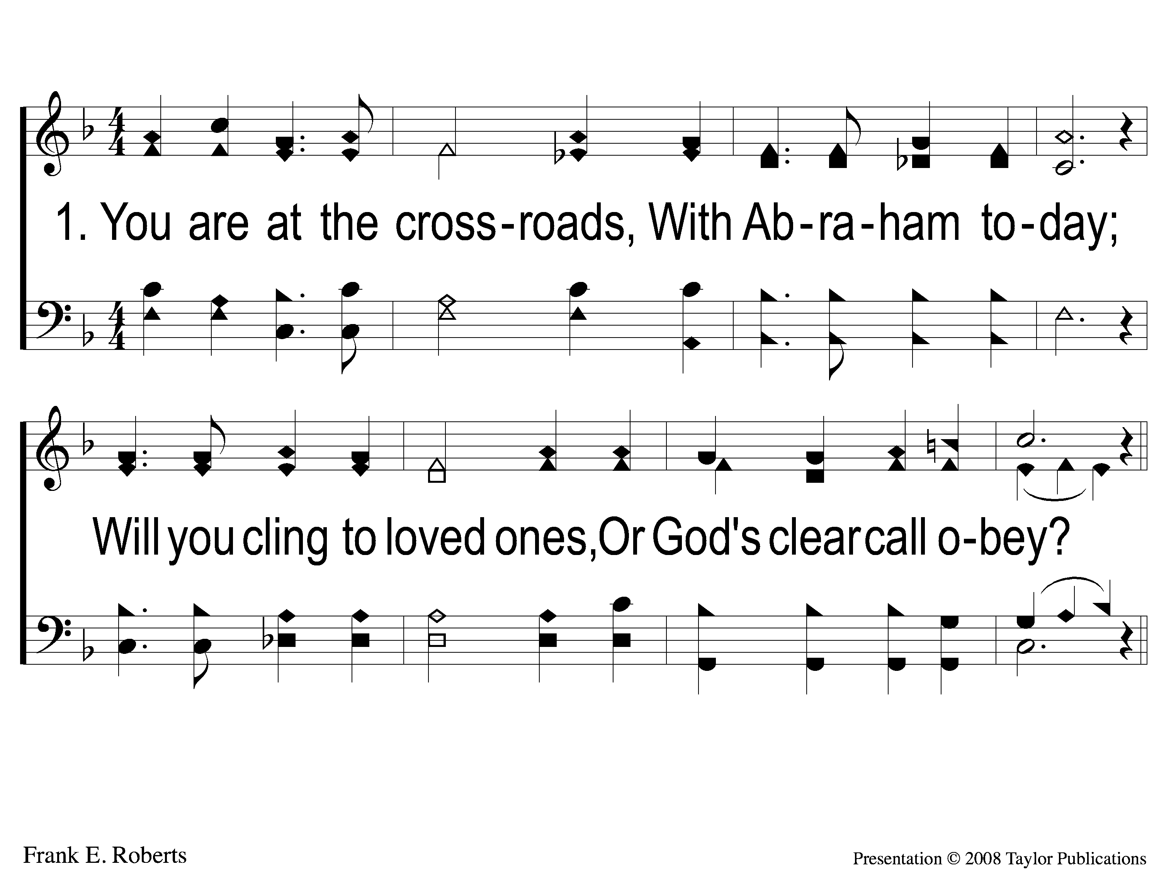
1 At the Crossroads
At the Crossroads
30

Slide 2
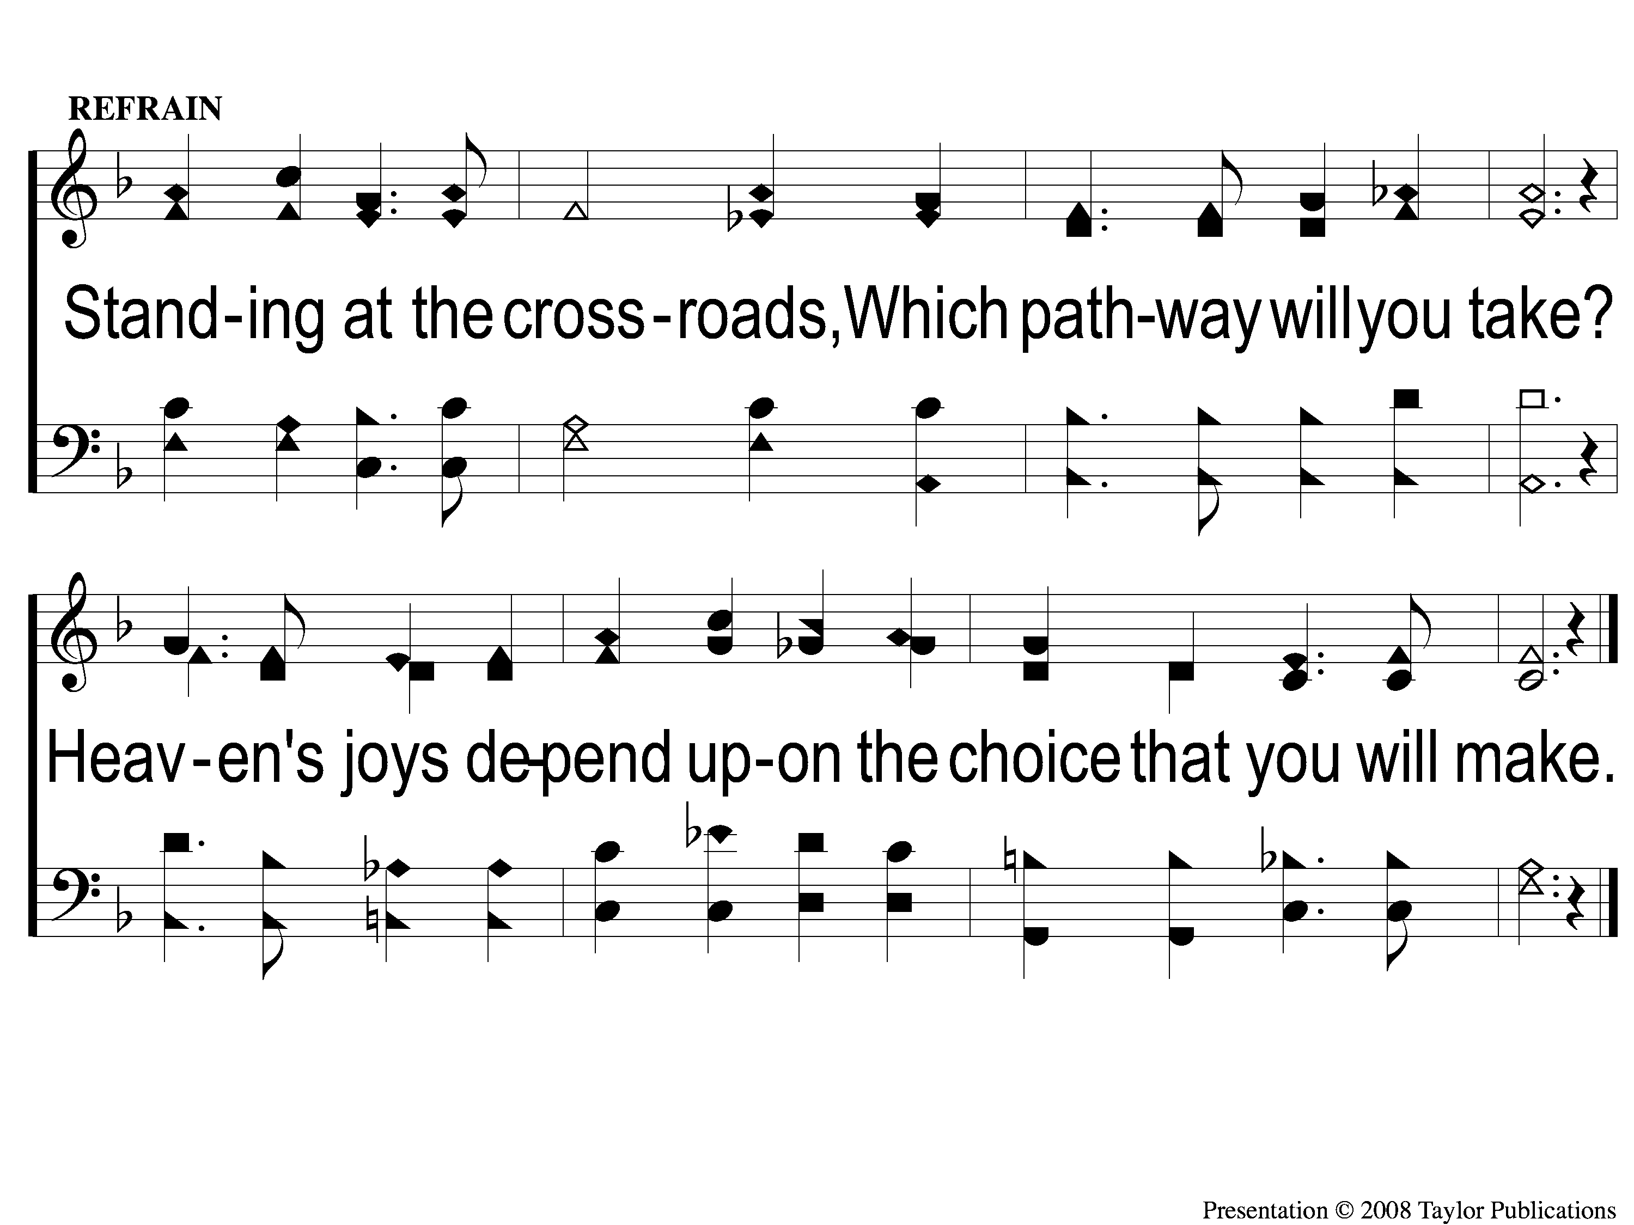
C At the Crossroads
At the Crossroads
30

Slide 3
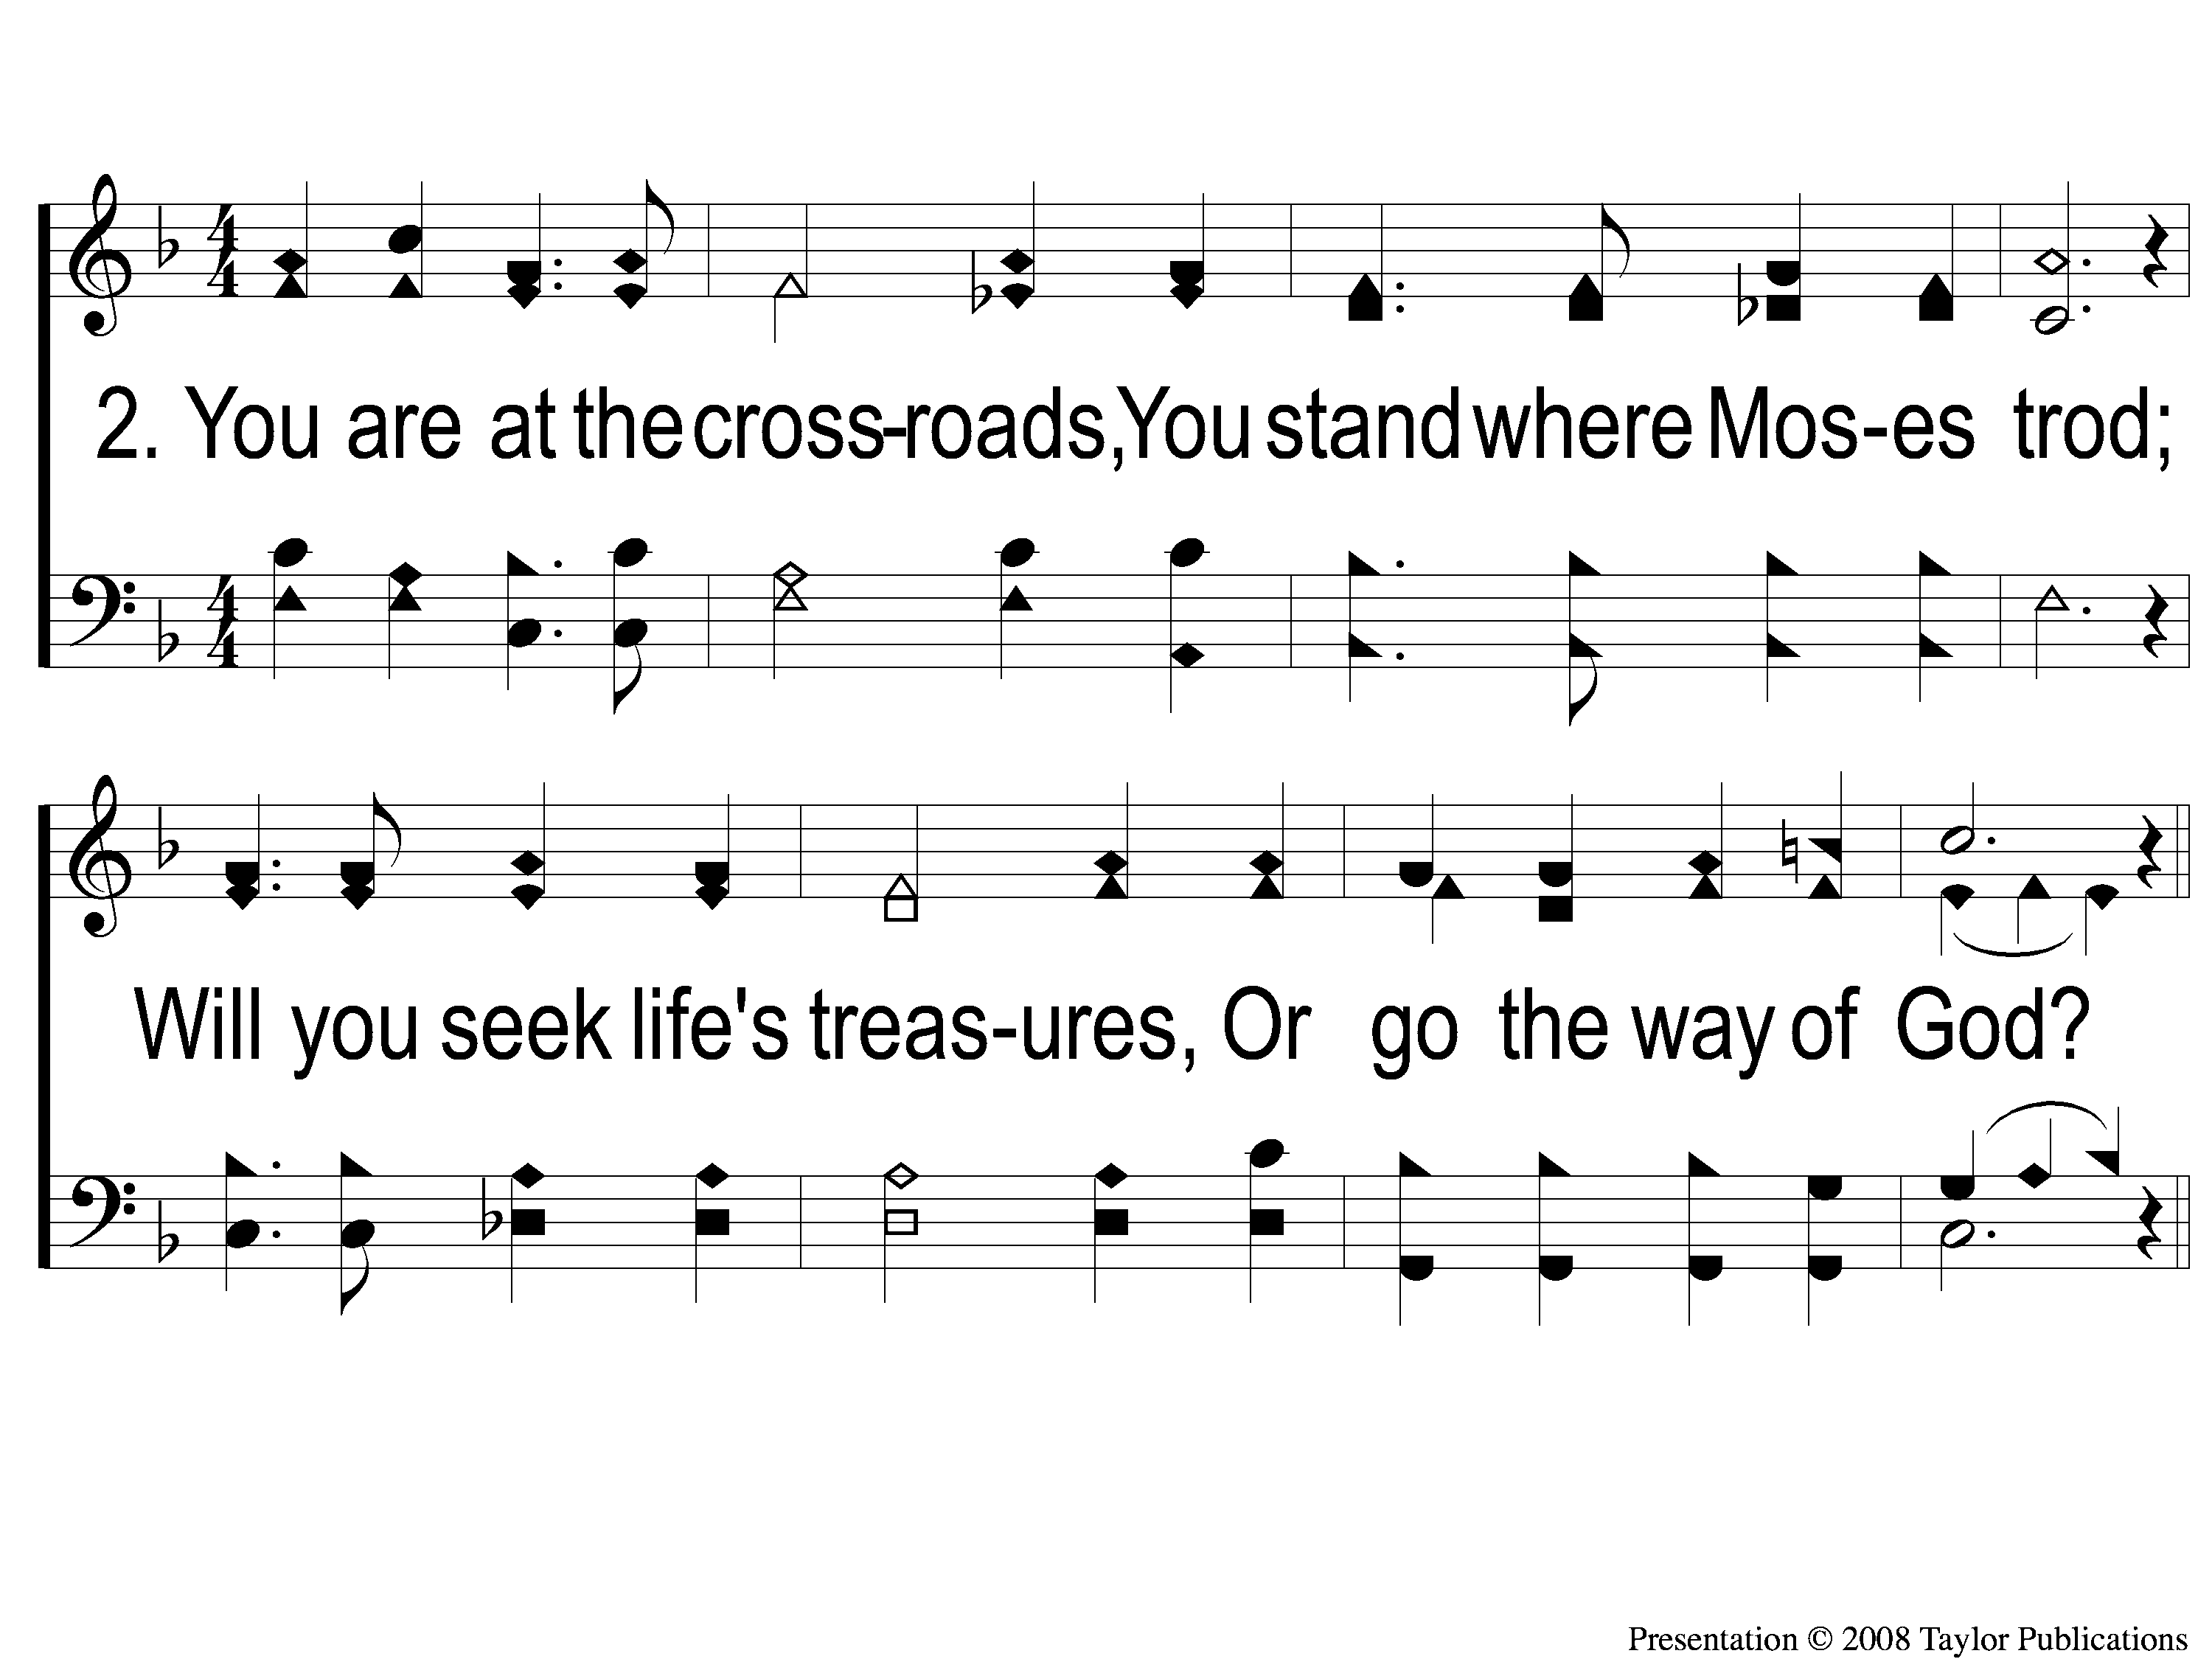
2 At the Crossroads
At the Crossroads
30

Slide 4
C At the Crossroads
At the Crossroads
30

Slide 5
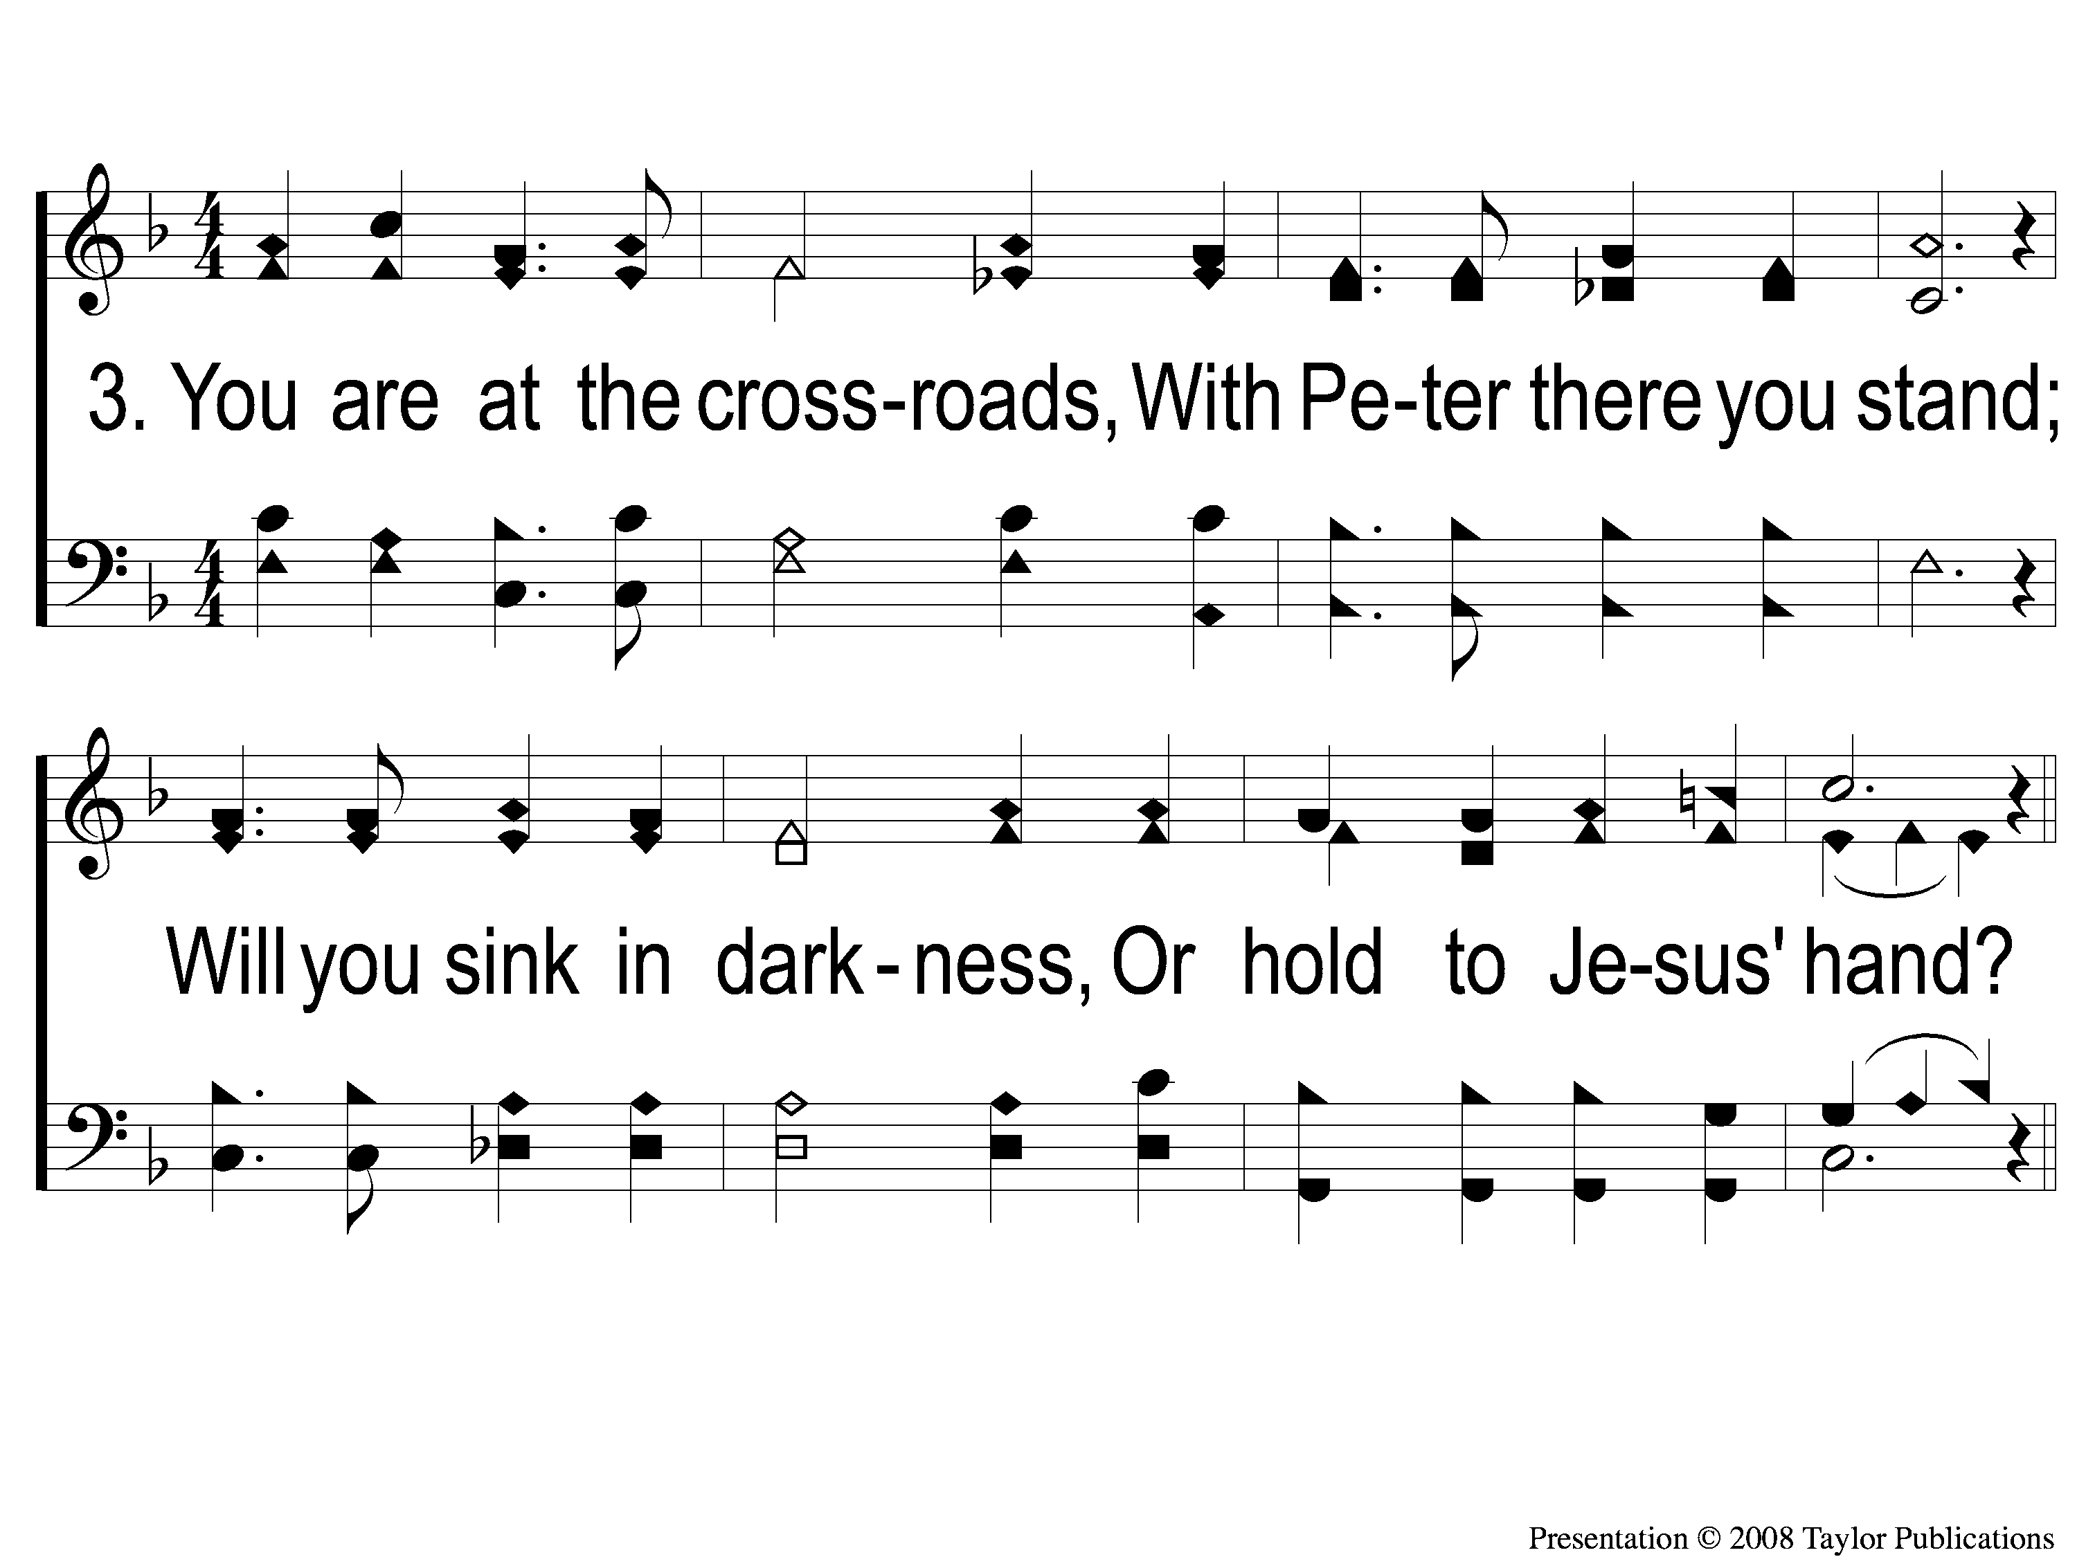
3 At the Crossroads
At the Crossroads
30

Slide 6
C At the Crossroads
At the Crossroads
30

